Slide 1
Project C
Clark Thurston

Slide 2
Executive Summary
After I upgraded our client’s IT equipment, they decided that they wanted to have a production server. It was my job to install and pentest the production server. I scanned the server with several versions of the NMAP command, and I have also looked up vulnerabilities of the box itself online. I have exploited four of the most dangerous vulnerabilities and cracked the passwords of the users on the server.

Slide 3
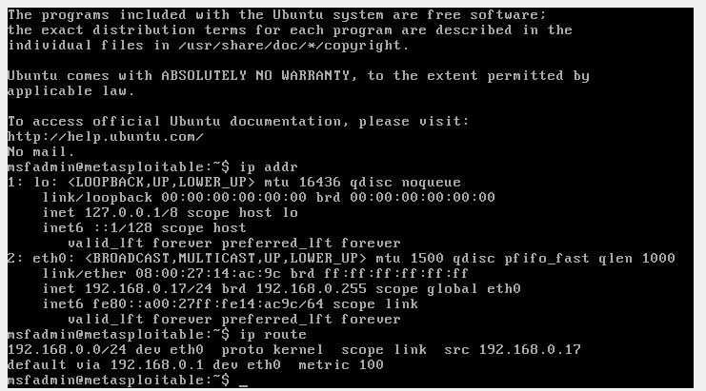
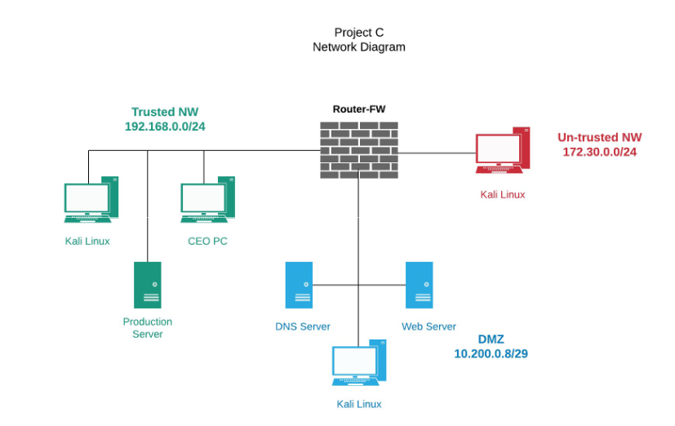
Connecting the Production Server

Slide 4

Descriptions of Vulnerabilities Found
I started off with a conventional NMAP scan to find the open ports, after I found the open ports, I used auxiliary scanners to find the versions of services running on the open ports.

Slide 5
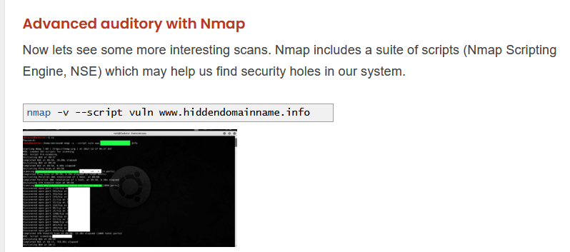
Description of Vulnerabilities, Cont.
That method was cumbersome and time consuming. During class one day, Scott brought up the vuln Nmap command. I used this, and it enumerated the vulnerabilities much more clearly.

Slide 6
Description of Vulnerabilities cONT.
I found out that the production server was running Metasploitable 2 when I used the “cat” command while running exploits. It was further revealed in class that both the web and production servers ran Metasploitable 2. I decided to search for vulnerabilities and exploits by box as well as through nmap and exploit databases.

Slide 7
Description of Vulnerabilities Cont.
I found 4 vulnerabilities that I decided to pursue:
ftp 2.34 on port 21
unreal ircd on port 6667
distcc_exec on port 3632
samba usermap script on port 139

Slide 8
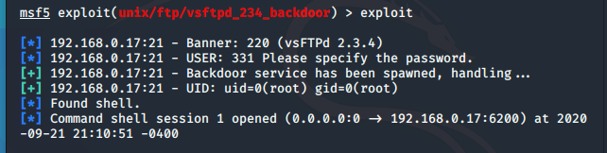
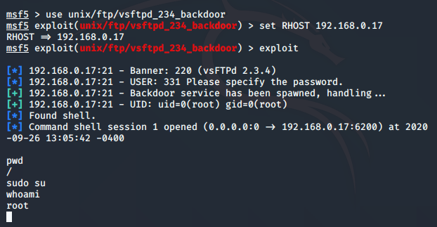
VSFtP 234 Backdoor Exploit

Slide 9
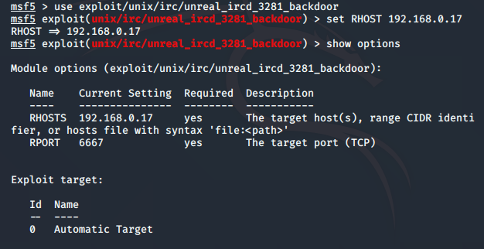
unreal_ircd_3281_backdoor Exploit

Slide 10
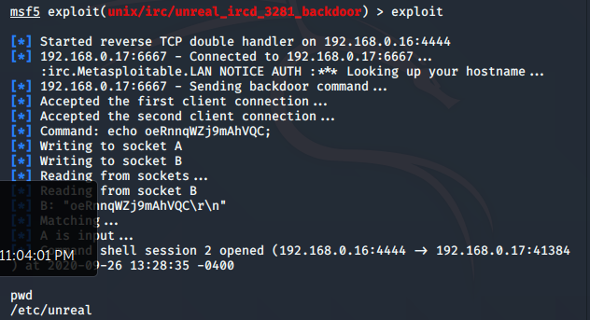
unreal_ircd_3281_backdoor Exploit

Slide 11
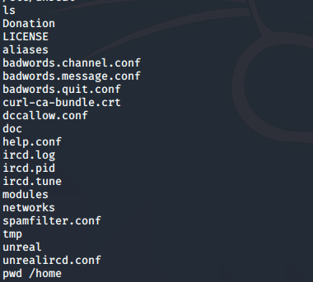

unreal_ircd_3281_backdoor Exploit

Slide 12
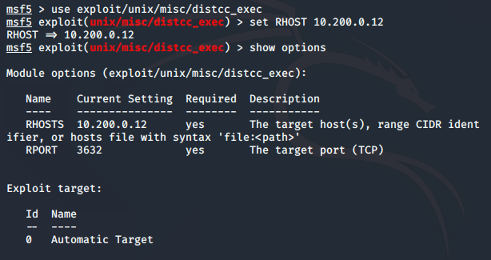
unix/misc/distcc_exec exploit

Slide 13
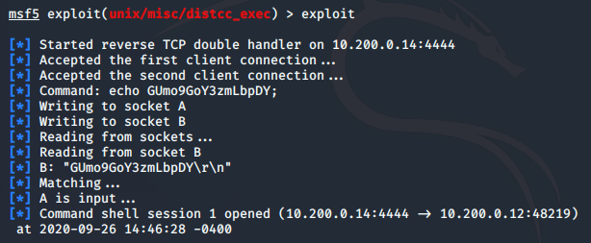
unix/misc/distcc_exec exploit

Slide 14
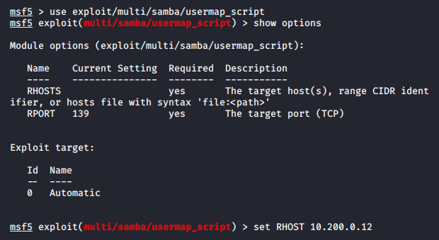
Samba Usermap Exploit

Slide 15
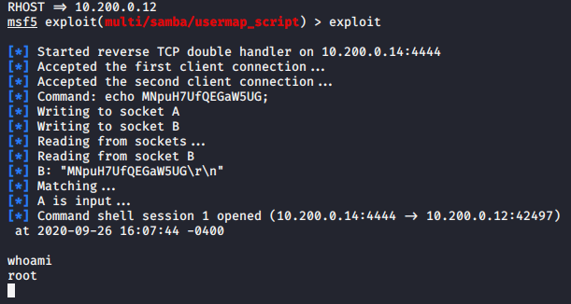
SAMBA USERMAP EXPLOIT

Slide 16
How I Created MY account oN the Production Server
I had to create my own account because the msfadmin user did not have root permissions.
I used an exploit that gave me root access, and I created my own account and escalated privileges.

Slide 17
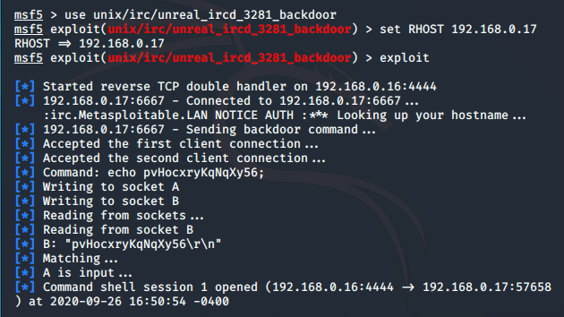
How I Created My own account on the production server cont.

Slide 18
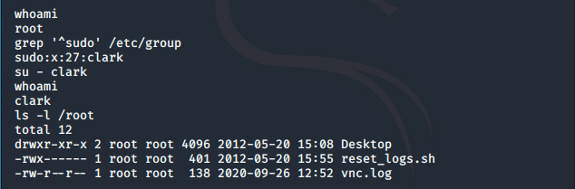
How I Created My own account on the production server cont.

Slide 19
How I Cracked the Passwords on the production servers
I used the “cat “command to show the /etc/password and /etc/shadow files. I had to use sudo permission to merge them both with the “unshadow “ command and used the “john” command to crack the password.
It listed the passwords in the shell, but I decided to show the merged.txt file to be less verborse.

Slide 20
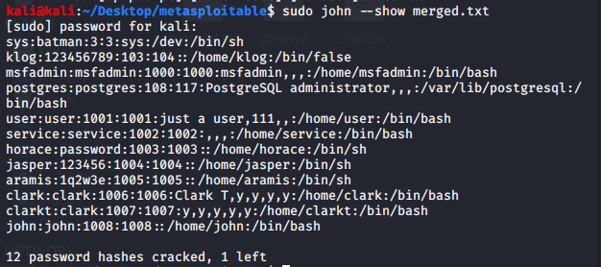
How I Cracked the Passwords on the production servers

Slide 21
Provide Recommendations to Improve Server Security
Specific Recommendations-I would remove Telnet on port 21 completely, and I would patch the remaining vulnerable services with later versions.
General Recommendations- Implement password policies and mandate mandatory patching of software and servers. I would also have a biannual pentest to make sure that these policies are adequate or to reassess them.

Slide 22

Sources Consulted

